Slide 1
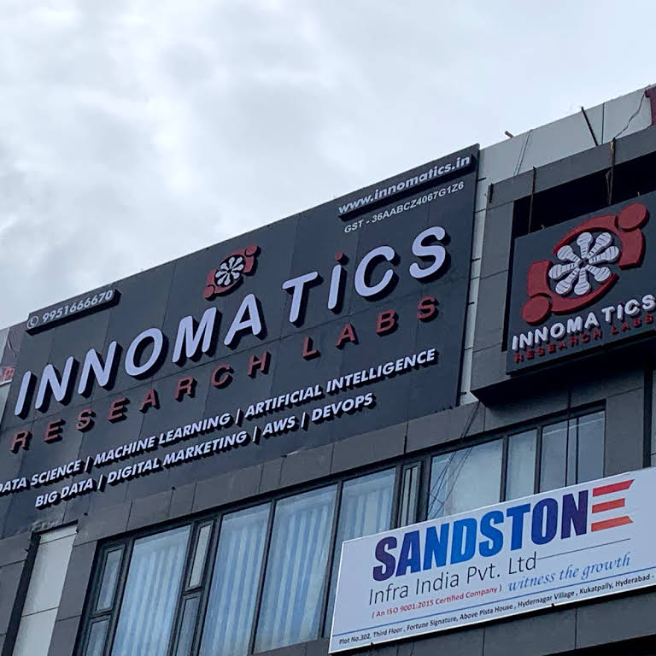
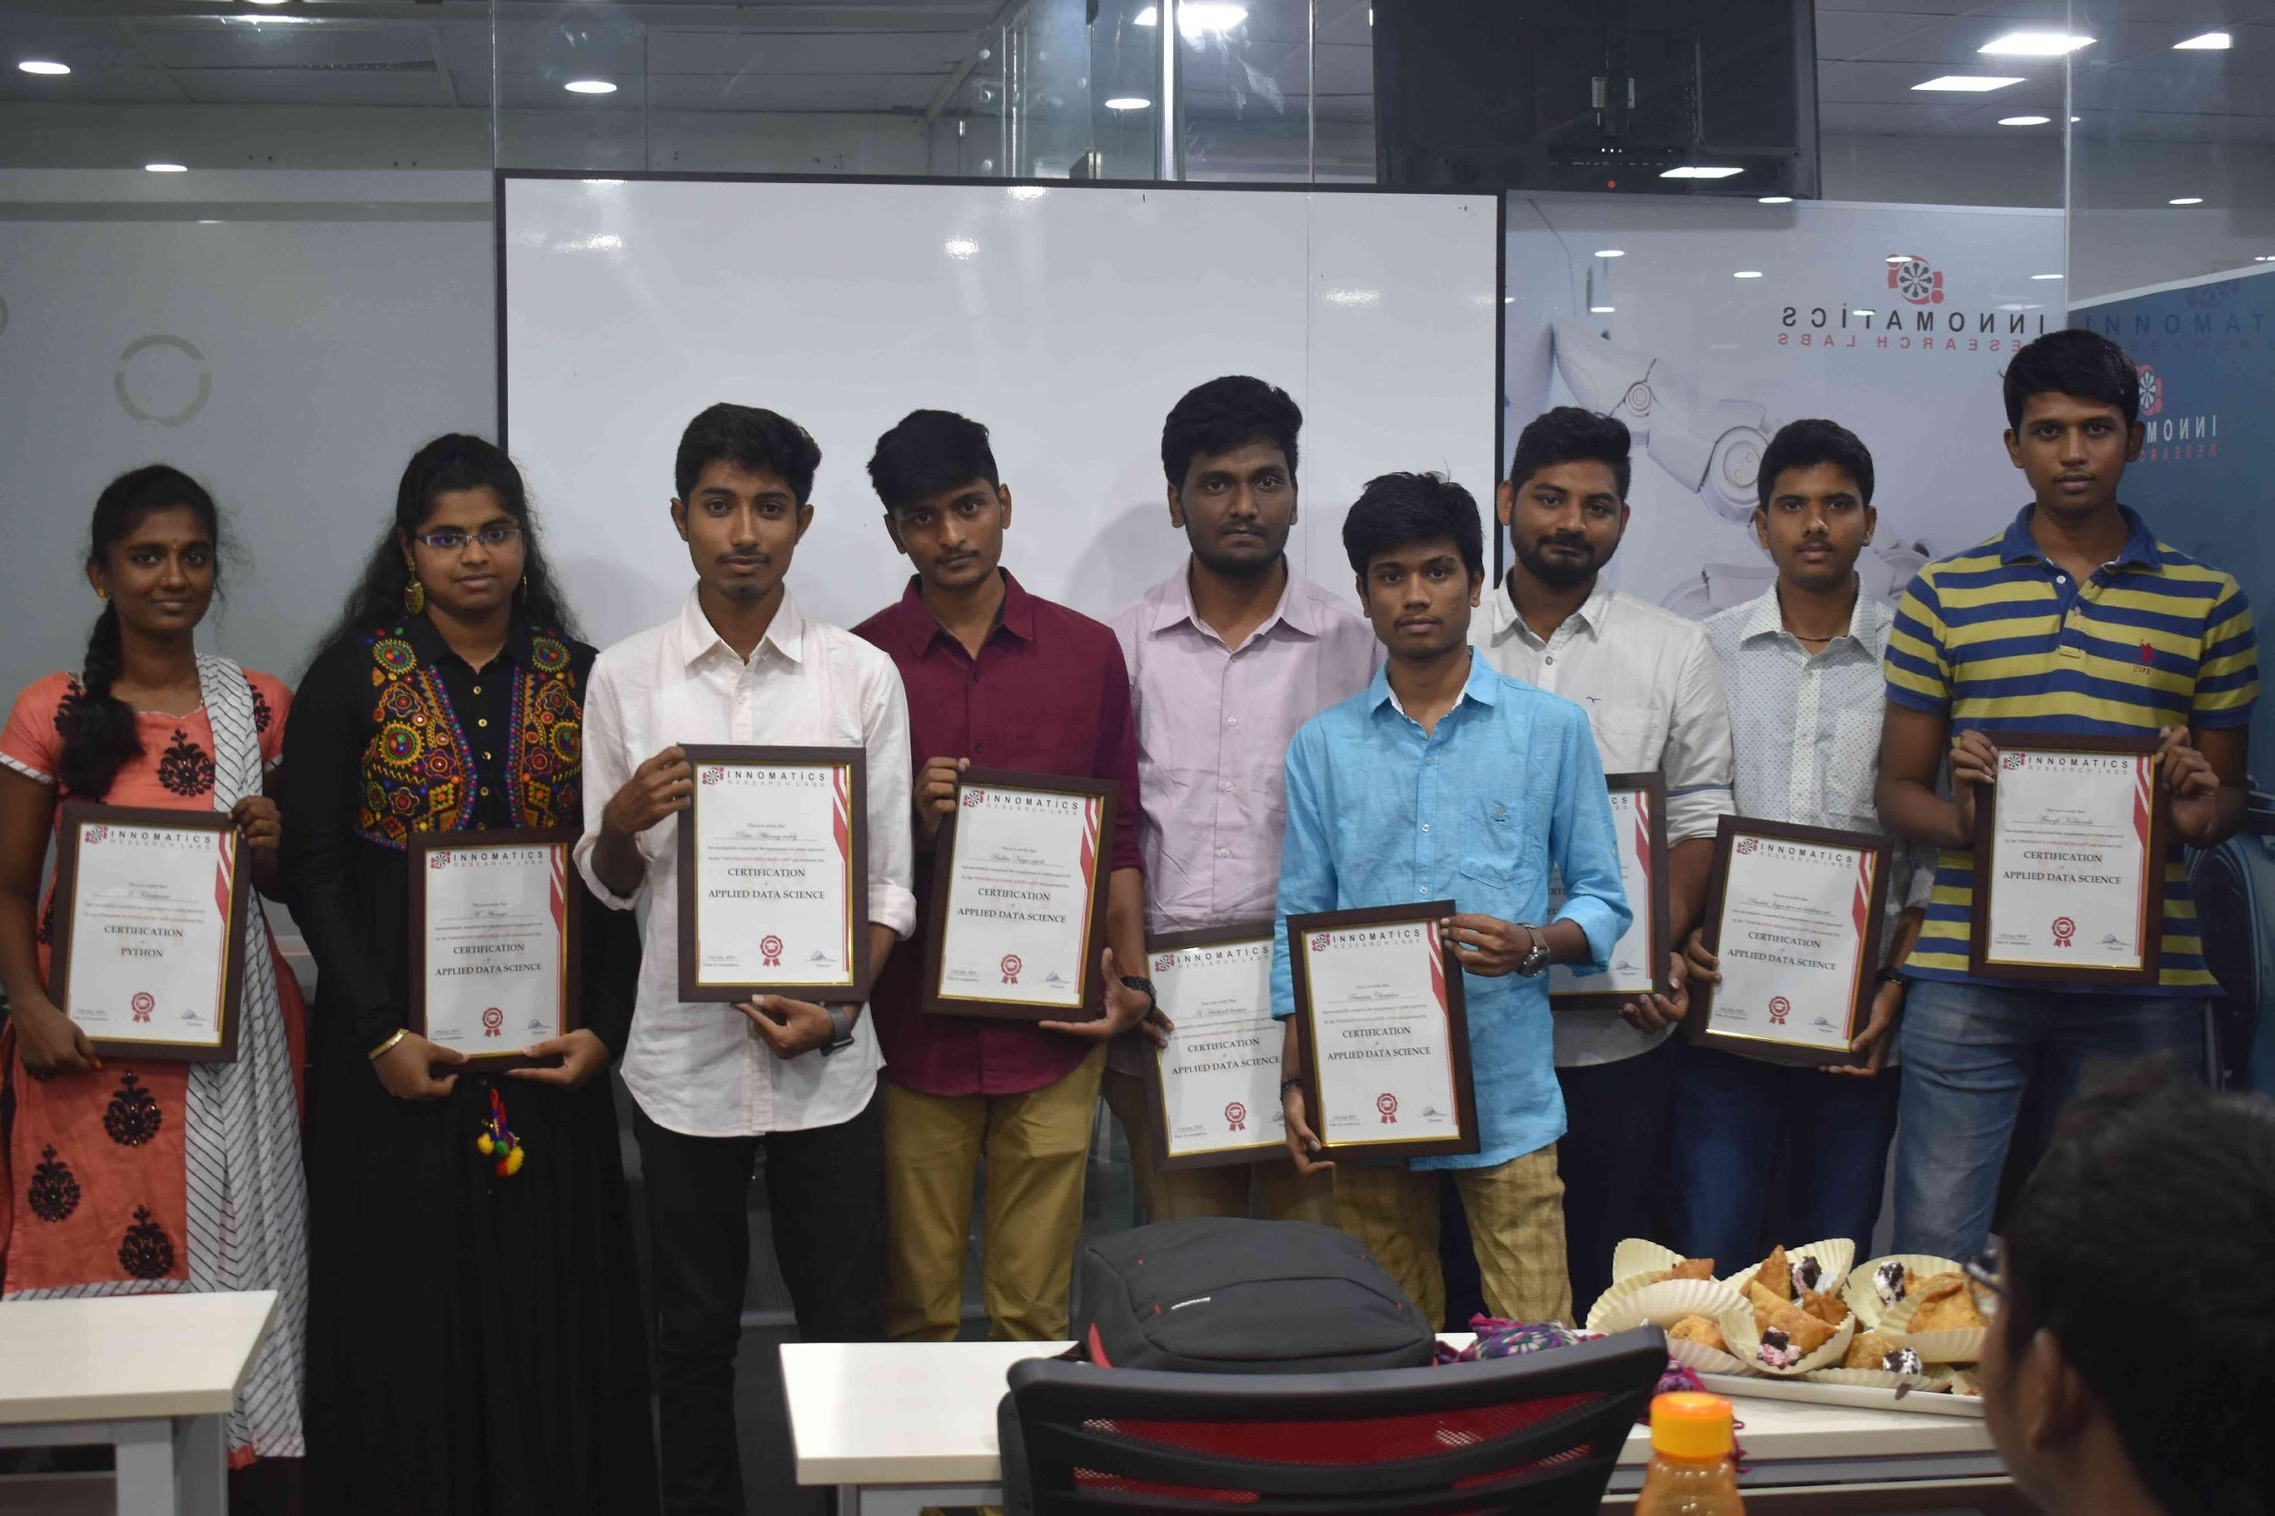
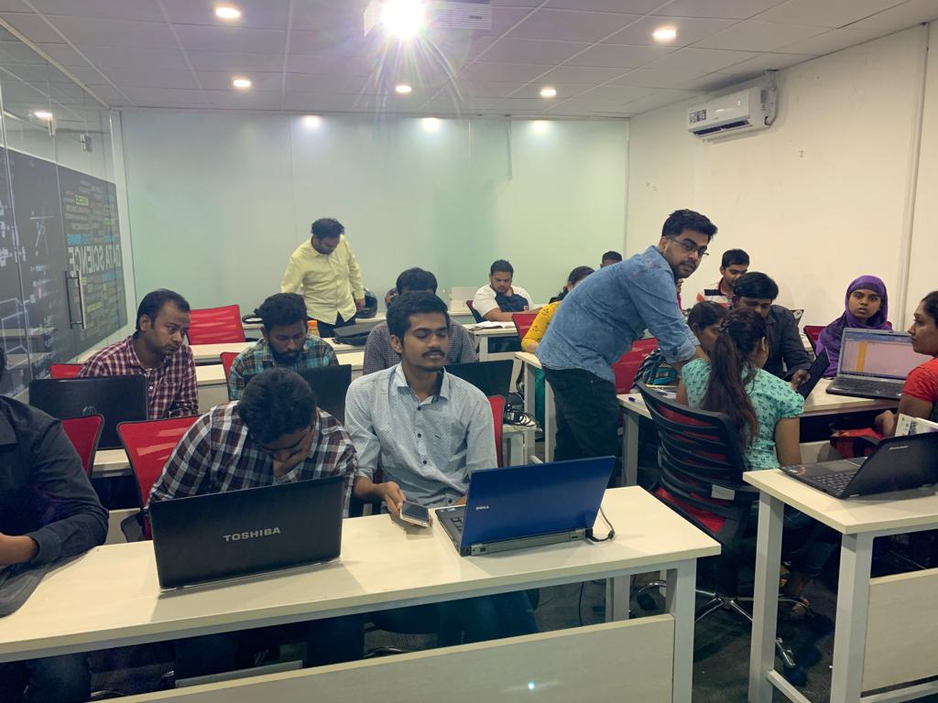

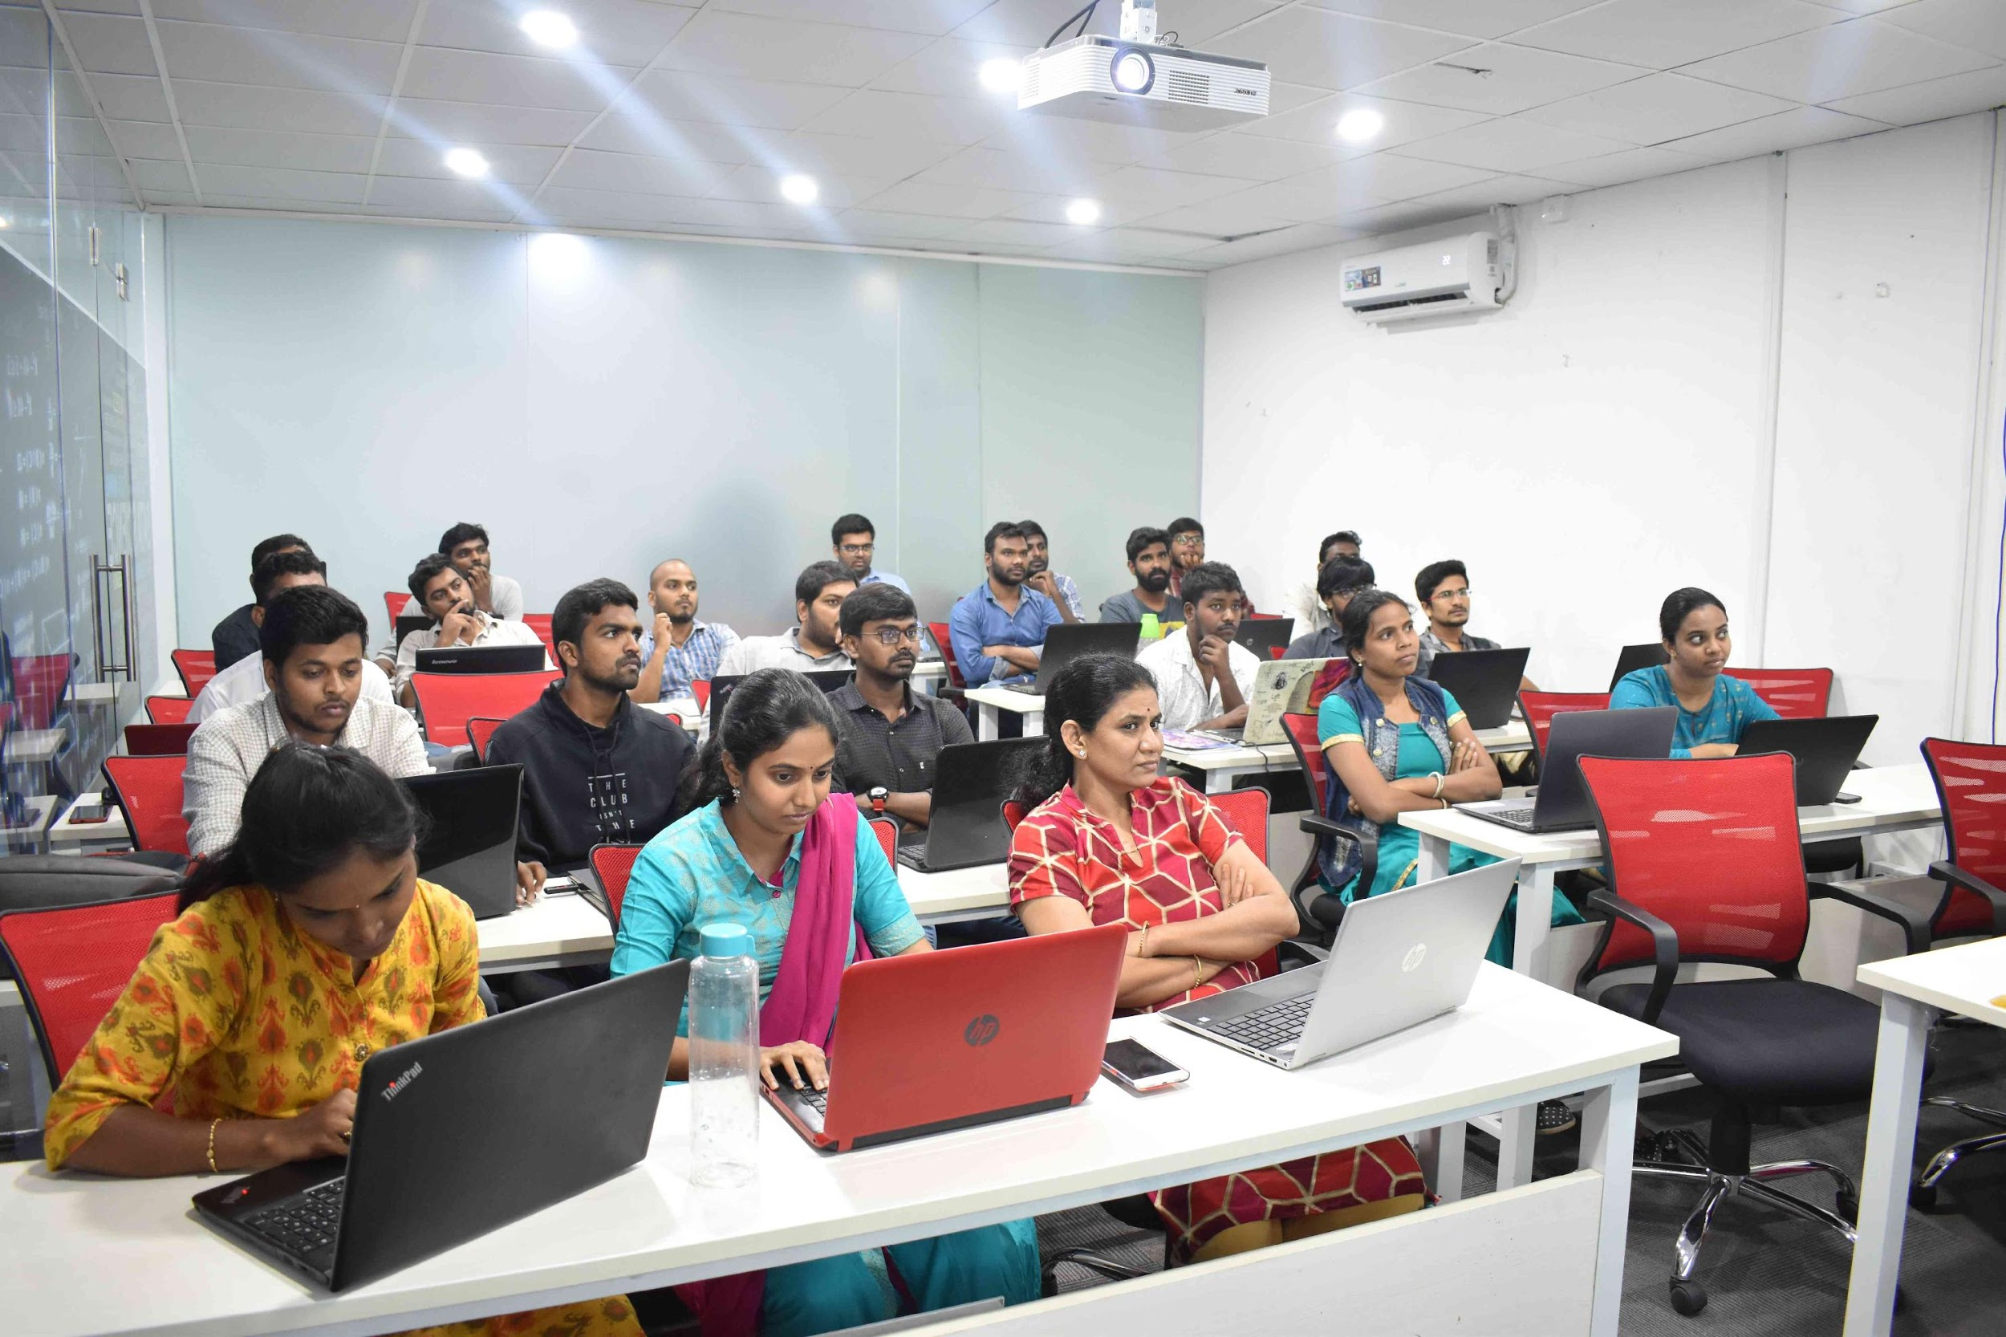
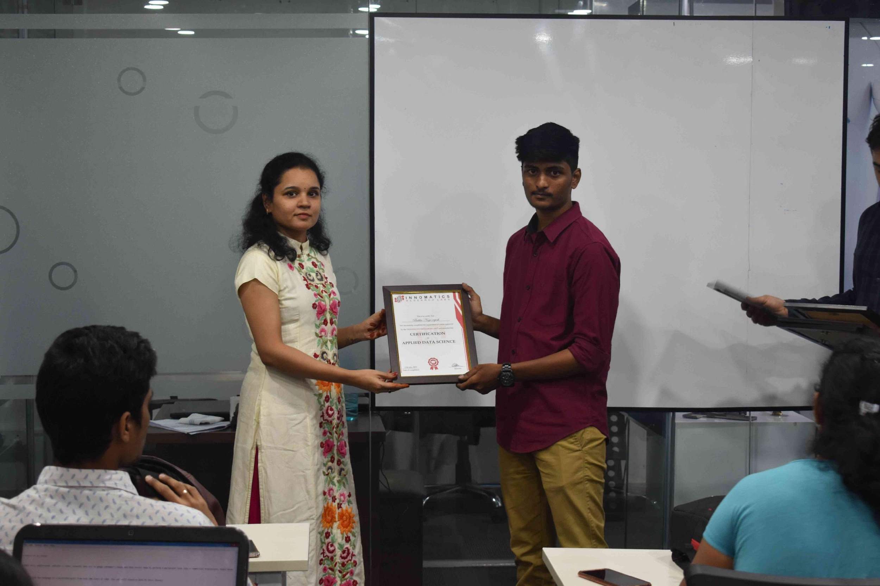
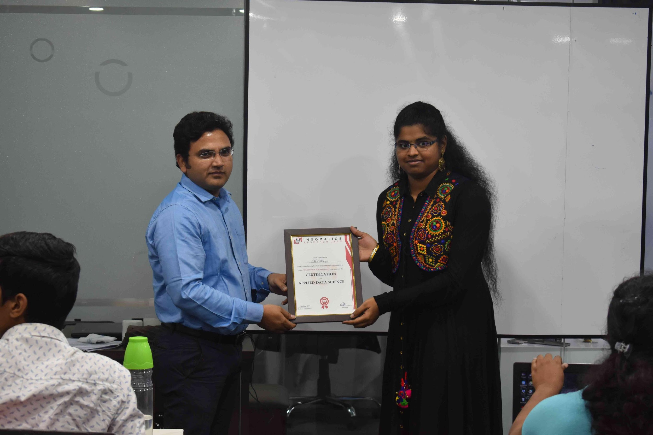

Slide 2
About me
Background ? (B-tech or M-tech)
B-tech ECE
Why you want to learn Data Science
For a Challenging career opportunity with ample growth
Any work experience
Nope-(Fresher)
What like you about Innomatics Research lab
Offline classes

Slide 3
Innomatics vs Competitors
Scraping online presence of Institutes

Slide 4
Business Use Cases:
Mapping of Social Media for tracking growth of Companies/institutes
Aggregate Reviews from various sources
Compare and evaluate the weak spots from collected data.

Slide 5
Scraping Methodology
Using Requests-Html Library to get the response and parse the data.
Using Requests-Html Library over Beautiful Soup cause this libaray emulates fake user agent by default.
Then using find function and Regex to extract data from Html.

Slide 6
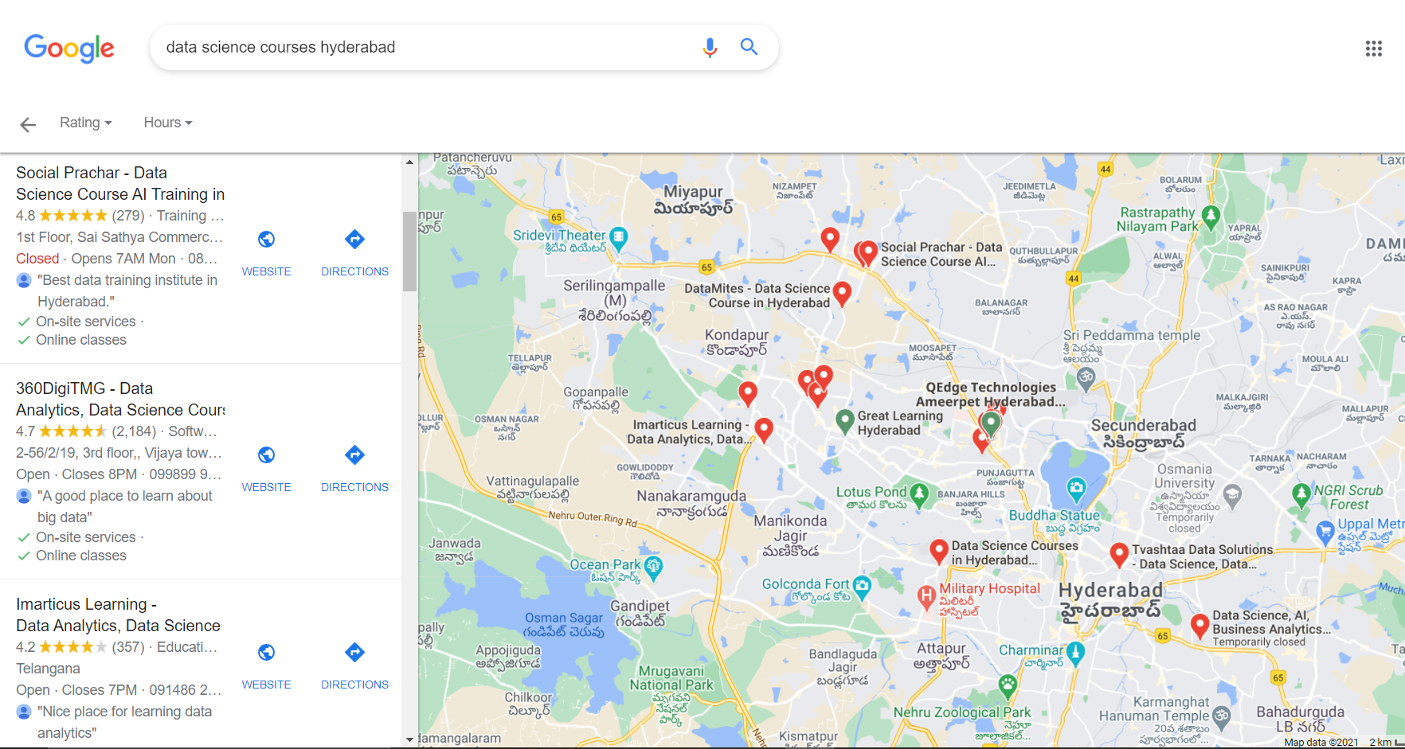
Query

Slide 7
URL Before cleaning:
https://www.google.com/search?&tbs=lrf:!1m4!1u3!2m2!3m1!1e1!1m4!1u2!2m2!2m1!1e1!2m1!1e2!2m1!1e3!3sIAE,lf:1,lf_ui:2&tbm=lcl&q=data%20science%20courses%20hyderabad&rflfq=1&num=10&sa=X&ved=2ahUKEwjAgcX-4ITwAhXF8XMBHRHRBdMQjGp6BAgJEGM&biw=1536&bih=754&dpr=1.25&rlst=f#rlfi=hd:;si:;mv:[[17.5055843,78.5269058],[17.3630076,78.3524396]];tbs:lrf:!1m4!1u3!2m2!3m1!1e1!1m4!1u2!2m2!2m1!1e1!2m1!1e2!2m1!1e3!3sIAE,lf:1,lf_ui:2
URL After cleaning(Removing Trackers):
Using urlclean.com
https://www.google.com/search?q=data+science+course+hyderabad&tbm=lcl

Slide 8
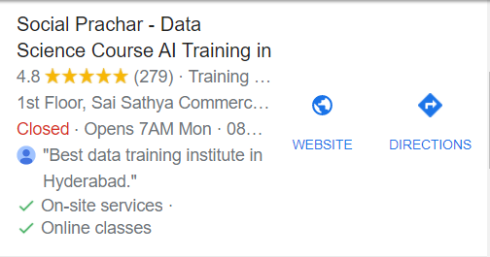
Total number of Results scraped : 170 from 9 pages.
Time module was used to add 2 sec delay for every page to avoid getting blocked
From this Block :
The Name , Stars , Number of Reviews and website using Html classes & Tags
Then the data was saved as Excel workbook for easier viewing of scraped data.
Data was then loaded as pandas dataframe and was Sorted by Reviews and Number of reviews.

Slide 9
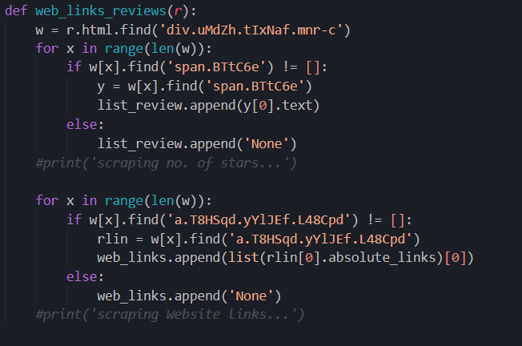
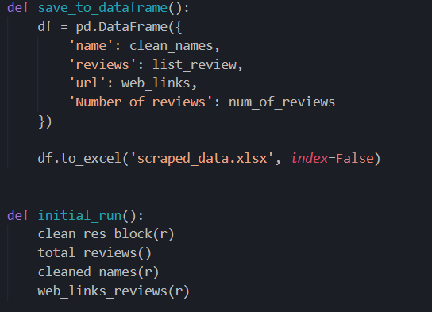
Some Code Snippets:

Slide 10
Extracting Instagram followers:
The top 30 results (After Sorting) was loaded.
First, the link for Instagram page was extracted from respective Institute Websites(Collected earlier from Google search results).
Number of followers were extracted using a module called Instaloader

Slide 11
EDA
The EDA was performed using, Pandas, Numpy for Sorting and other calculations.
Matplotlib and seaborn was used for plotting & Visualizing the data

Slide 12
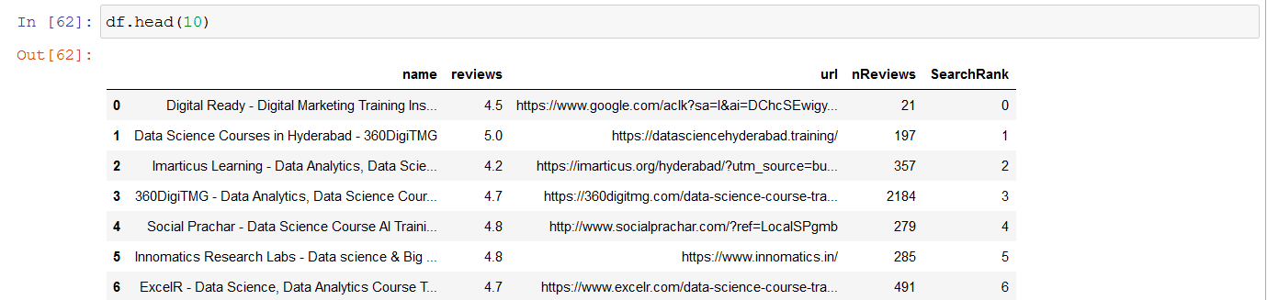
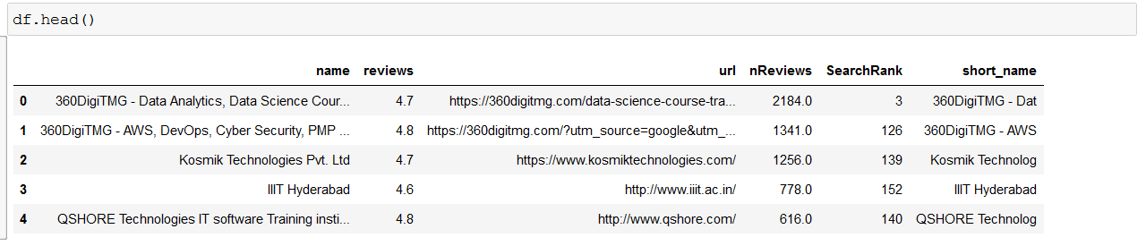
Raw Scraped Data:
Sorted Scraped Data:

Slide 13
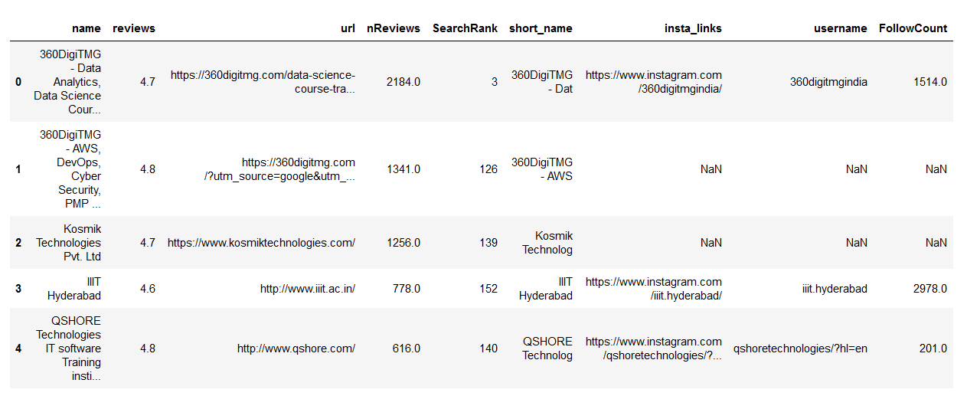
Final Dataframe

Slide 14
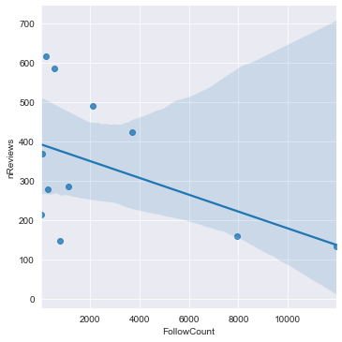
Insta Followers vs No. of Reviews(Lmplot)
The Graph shows a negative correlation between No. Reviews and Followers

Slide 15
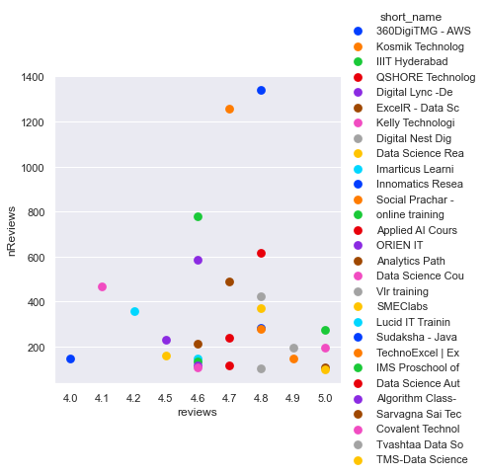
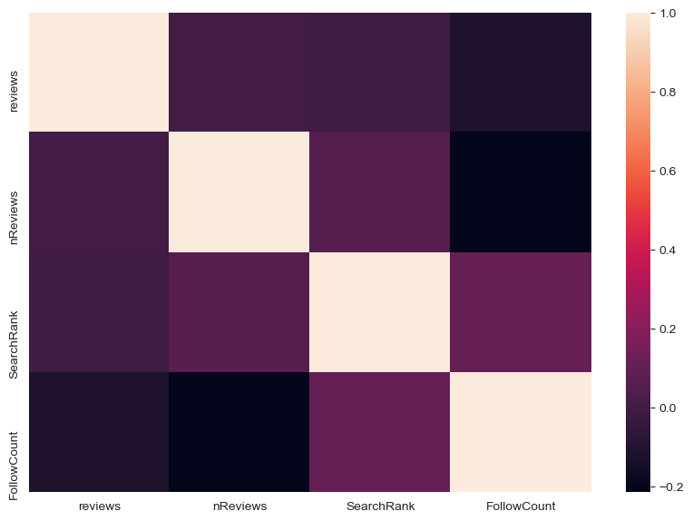
Reviews vs No. of Reviews & Heatmap

Slide 16
Further Reduction using some analytical reasoning:
Dropping 'QSHORE' cause the Institute seems to be closed (Latest reviews are about a year old)
Dropping Institutes with High Number of Google reviews and Very low Instagram Followers(Reachout & Analytics Path)
Dropping Institutes which do not mention Course Fees on their Sites (Sudaksha & SMEclabs)
Dropping IIIT Hyderabad(in collab with Great Learning) cause course fees(350,000) not in range of others.
Dropping any Institutes with Search Rank > 100

Slide 17
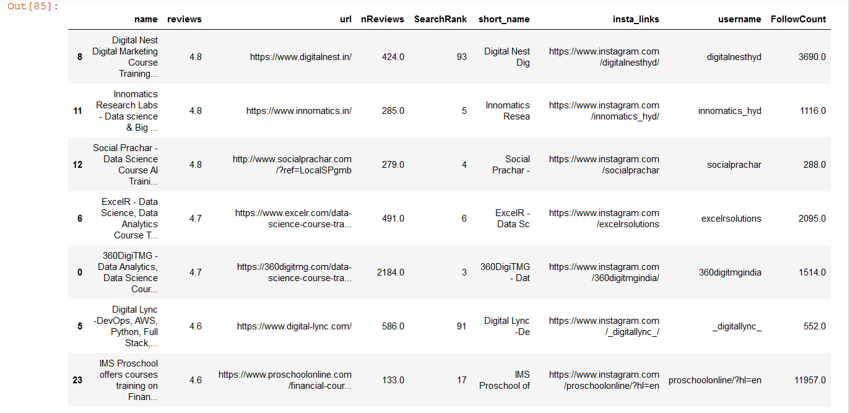
Final top institutes acc. To the Analysis till now

Slide 18
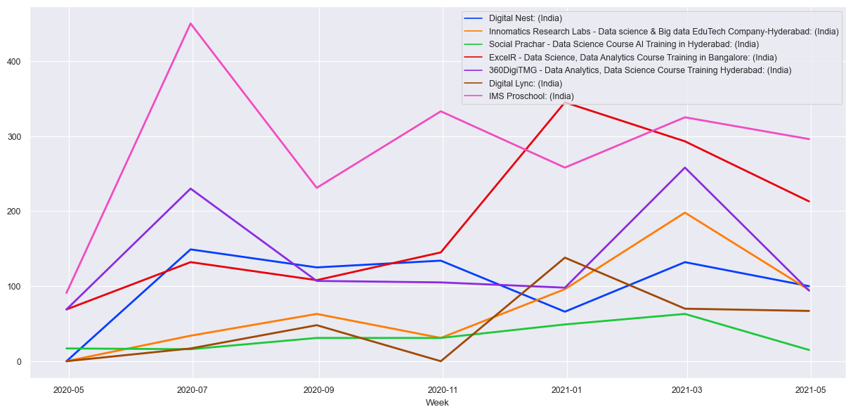
Google Trends Report for our top 7 Institutes:

Slide 19
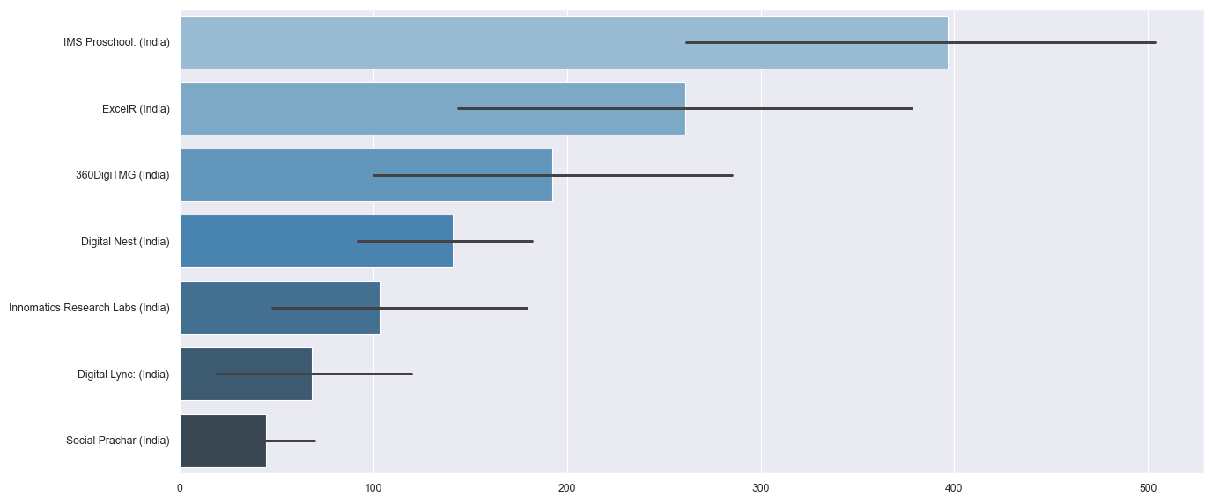

Slide 20
Conclusion
Innomatics Search Rank is always in 10 top for Hyderabad.But is over run by other company ads
Innomatics lags behind 360DigiTMG and Digital in online presence
Innomatics also lacks presence in other states of India

Slide 21
Future Work
Using Api calls for Getting data on large scale.
In-depth mapping of every Media account
Reviews Sentiment Analysis

Slide 22

THANK YOU

